Slide 1



Martock and South Petherton Surgery's
APEX Data
January 2025
www.symphonyhealthcareservices.com
@symphony_SHS

Slide 2

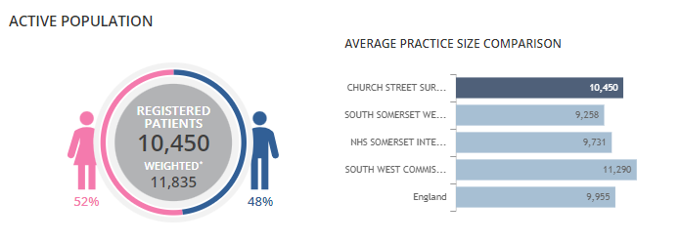
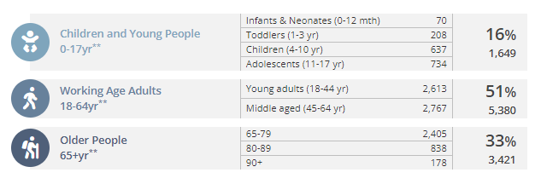
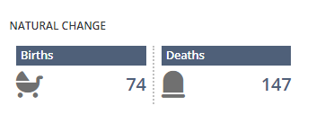
Practice population
www.symphonyhealthcareservices.com
@symphony_SHS

Slide 3
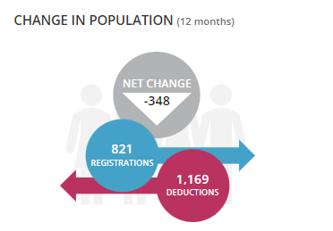
PATIENT POPULATION DEDUCTIONS V REGISTRATIONS
www.symphonyhealthcareservices.com
@symphony_SHS
Notes:
Include DBS checks enhanced

Slide 4
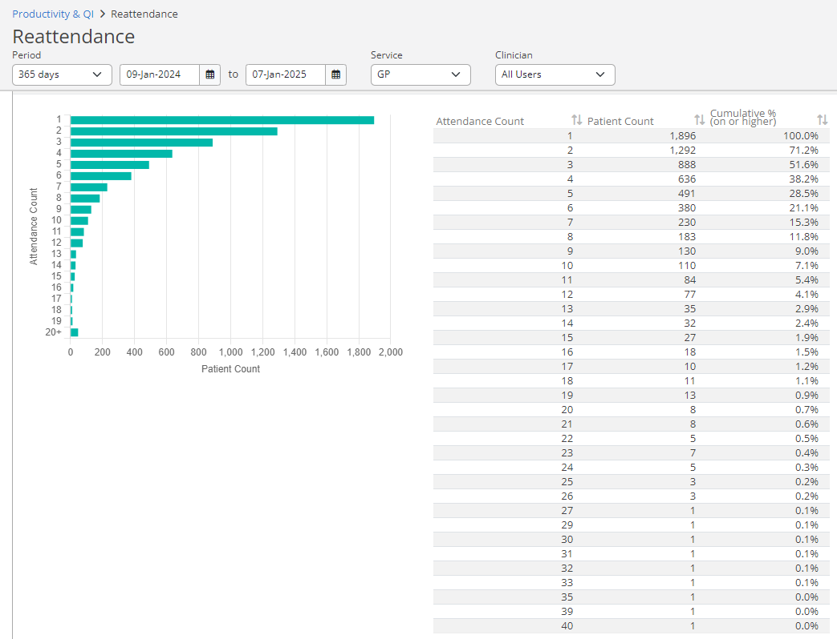
REATTENDANCE
www.symphonyhealthcareservices.com
@symphony_SHS
Notes:
Include DBS checks enhanced

Slide 5
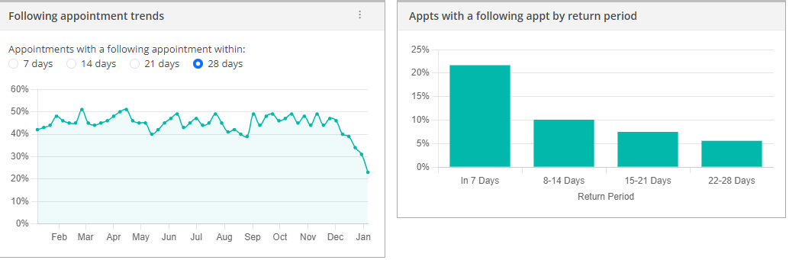
REATTENDANCE CONT..
www.symphonyhealthcareservices.com
@symphony_SHS
Notes:
Include DBS checks enhanced

Slide 6
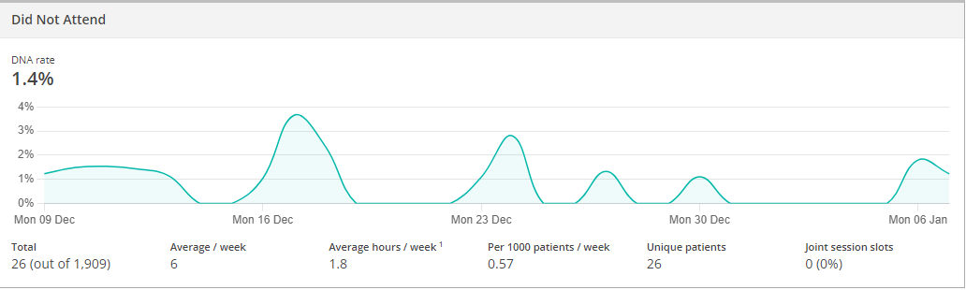
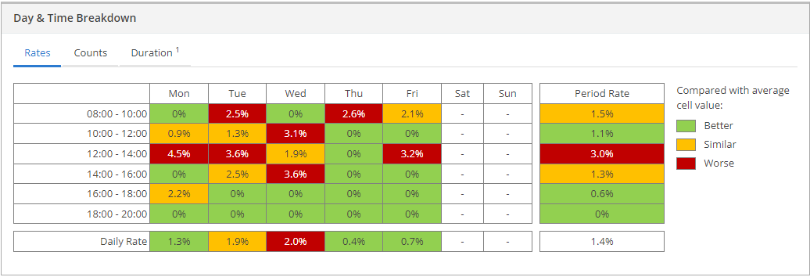
Did not attend..
www.symphonyhealthcareservices.com
@symphony_SHS
Notes:
Include DBS checks enhanced

